Slide 1
Challenge Set: Technology for Good in the Global South

Slide 2
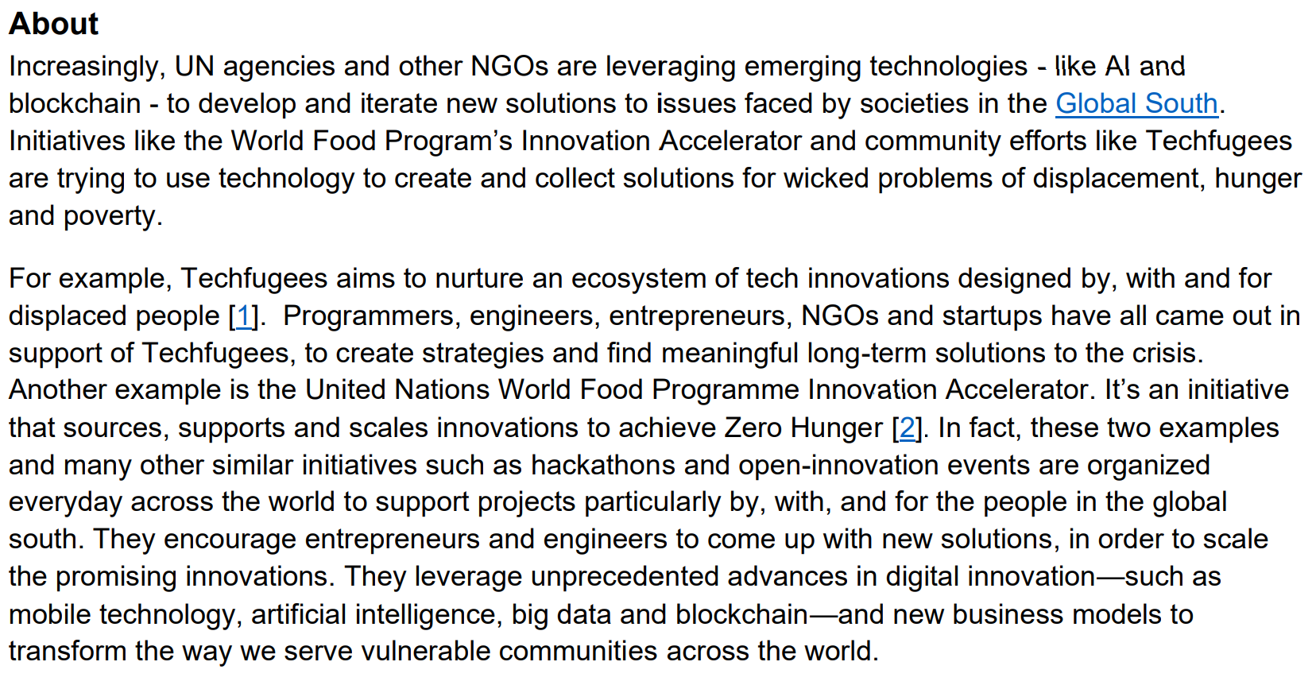

Slide 3
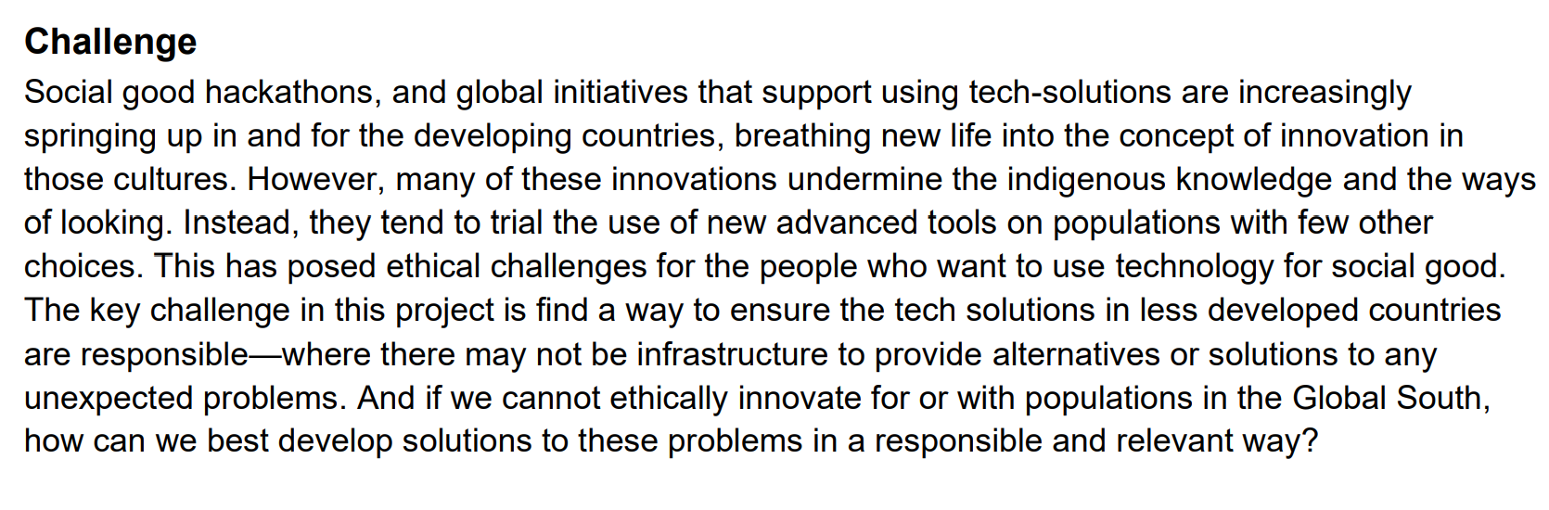

Slide 4
Global South Workshop Project Requirements
 | Yes / No | How has this been achieved? | How / where has this been documented?
Have you?
Identified the social, ethical and technical challenges for the people who want to use technology for social good / hackathons. | Yes / No
Identified how/why/when some technology for social good technology innitiatives undermine the indigenous knowledge and the ways of looking. | Yes / No
Explored the ethical problems created by lack of access to infrastructure, lack of alternatives or limited solutions to any unexpected problems arising from these 'technology for social good projects'. | Yes / No
Identified stakeholders of the 'technology innovation for social good' project as well as their needs and values | Yes / No
Identified a way to ensure the tech solutions in less developed countries are responsible, where there may not be infrastructure to provide alternatives or solutions to any unexpected problems. | Yes / No
Identified how can we best develop solutions to these problems in a responsible and relevant way if we cannot ethically innovate for or with populations in the Global South | Yes / No

Slide 5
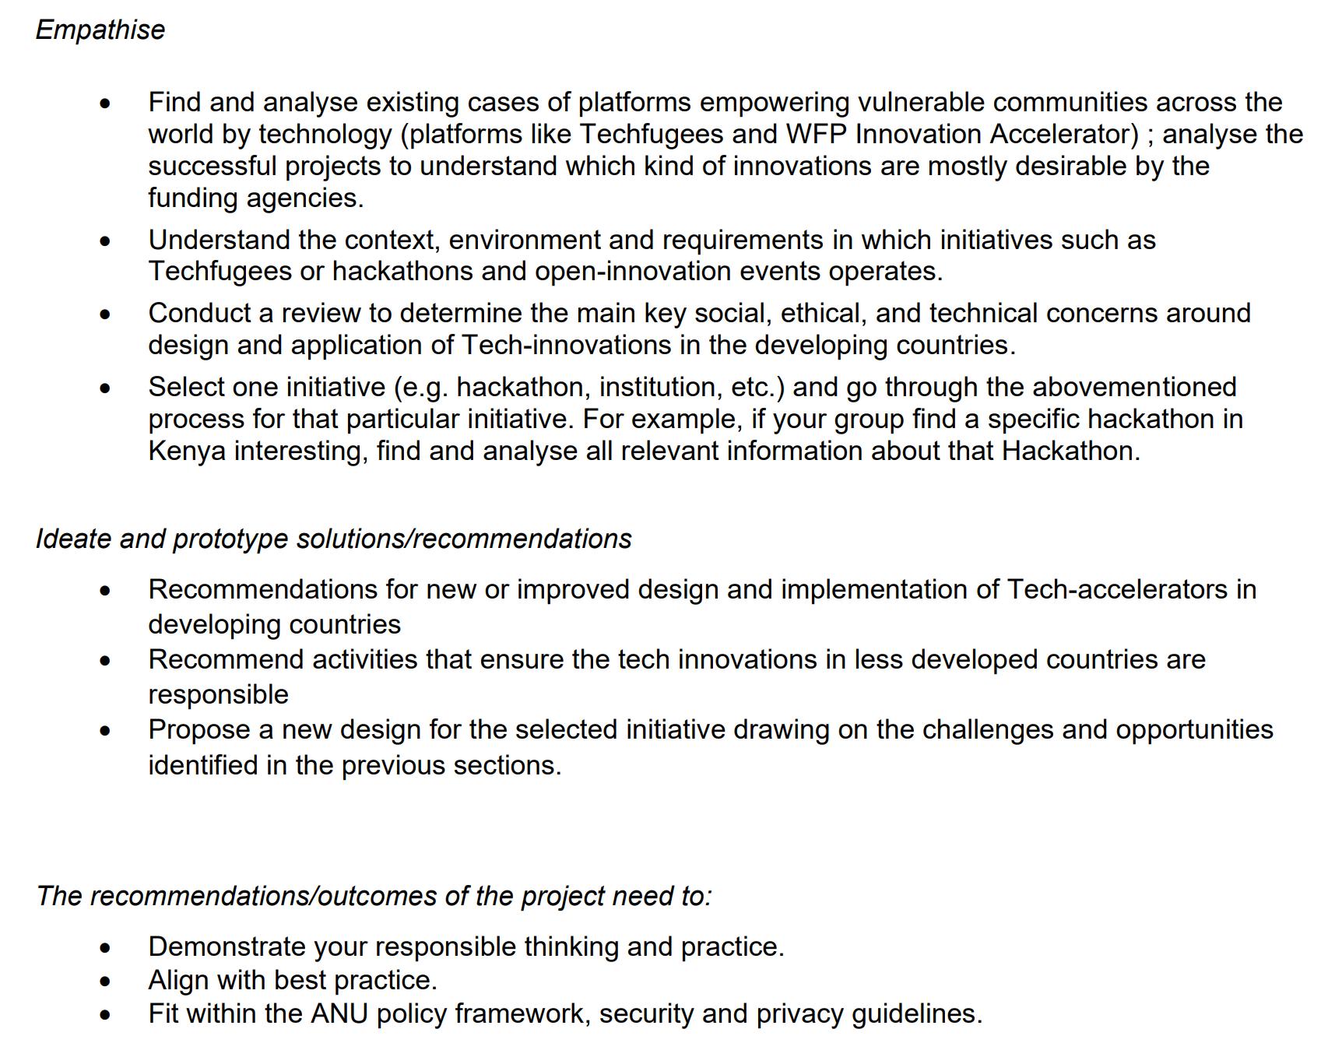

Slide 6
Quick Workshop Project Review
 | Have we completed this task? | How have we completed this requirement? | How can we display we have completed this requirement? | Which Workshop Assessment is this relevant to?
 | Select Yes or No | List Activities Completed (Stakeholder Mapping, Empathy Map, Secondary Research Etc) |  | White Paper, Podcast, Group Presentation, Individual Reflective Piece or Workshop Contribution
Empathise
Find and analyse existing cases of platforms empowering vulnerable communities across the world by technology (platforms like Techfugees and WFP Innovation AccelA4:A8erator) | Yes / No
Analyse the successful projects to understand which kind of innovations are mostly desirable by the funding agencies. | Yes / No
Understand the context, environment and requirements in which initiatives such as Techfugees or hackathons and open-innovation events operates. | Yes / No
Conduct a review to determine the main key social, ethical, and technical concerns around design and application of Tech-innovations in the developing countries. | Yes / No
Select one initiative (e.g. hackathon, institution, etc.) and go through the abovementioned process for that particular initiative. For example, if your group find a specific hackathon in Kenya interesting, find and analyse all relevant information about that Hackathon. Ideate and prototype solutions/recommendations | Yes / No
Ideate and prototype solutions/recommendations
Recommendations for new or improved design and implementation of tech-accelerators in developing countries | Yes / No
Recommend activities that ensure the tech innovations in less developed countries are responsible | Yes / No
Propose a new design for the selected initiative drawing on the challenges and opportunities identified in the previous sections | Yes / No
The recommendations/outcomes of the project need to:
Demonstrate your responsible thinking and practice. | Yes / No
Align with best practice. | Yes / No
Fit within the ANU policy framework, security and privacy guidelines. | Yes / No

